Slide 1
Fin BluePrint: Introduction to Financial Planning
VISHAL DALAL – Certified Financial Planner [CFP^{CM}]

Slide 2

Contents
Introduction
Asset Allocation
Common Misconceptions & Stats
Sample Case study

Slide 3
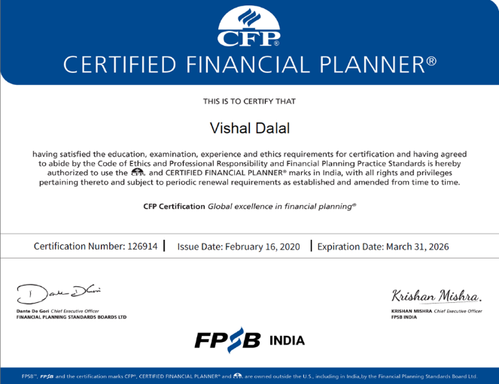
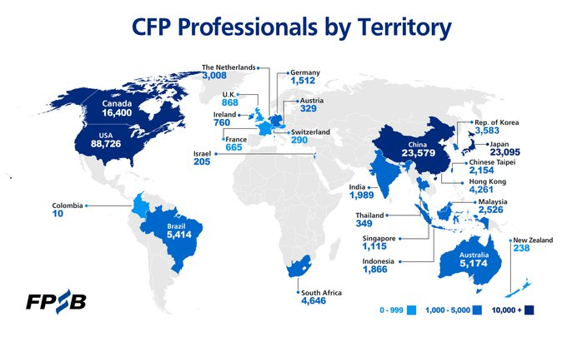
Introduction
Certified Financial Planner
24+ years corporate experience, primarily in MNC banks
Achieved Financial Independence, Retire Early (FIRE)

Slide 4

What is Financial Planning?
Process of meeting your life goals through proper management of your finances

Slide 5
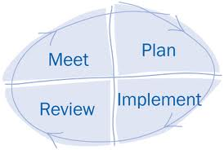
Financial Planning Process
Data Collection
Goal setting
Current Analysis
Draft Plan
Final Plan
Product Suggestions
Execution
Follow ups
Monitoring
Query Solving

Slide 6
Asset Allocation – Some Quotable Quotes
The most important key to successful investing can be summed up in just two words - asset allocation.
Michael LeBoeuf, well-known American business author
“Much success can be attributed to inactivity. Most investors cannot resist the temptation to constantly buy and sell.”
Warren Buffet, investor, chairman and CEO of Berkshire Hathaway
The difference between success and failure is not which stock you buy or which piece of real estate you buy, it’s asset allocation.
Tony Robbins, American author, coach, speaker, and philanthropist
“The four most dangerous words in investing are: ‘this time it’s different’.”
John Templeton, British investor, banker, fund manager, founder of Templeton Fund
You should have a strategic asset allocation mix that assumes that you don’t know what the future is going to hold.
Ray Dalio, American billionaire businessman, hedge fund manager, author

Slide 7
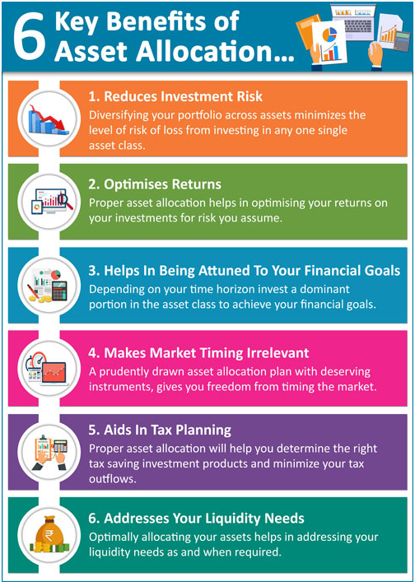

Slide 8
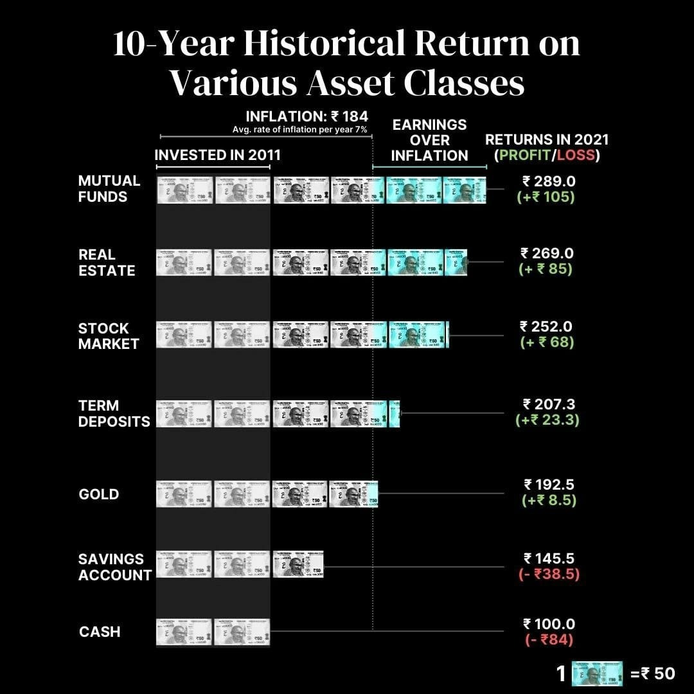
Asset Classes & Historical Returns (India)

Slide 9
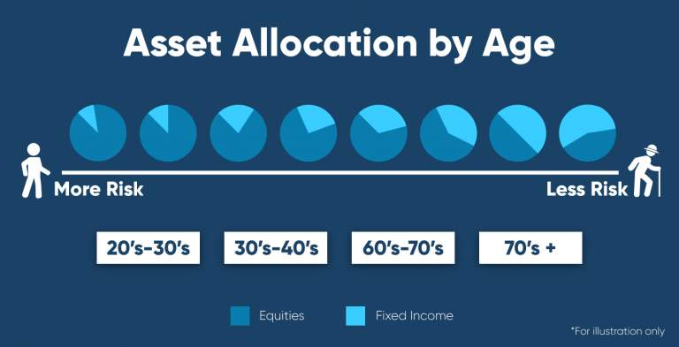
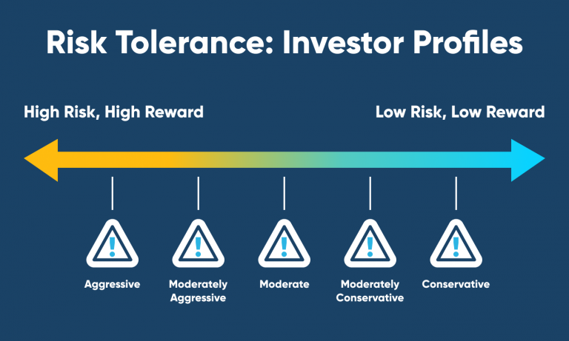

Slide 10
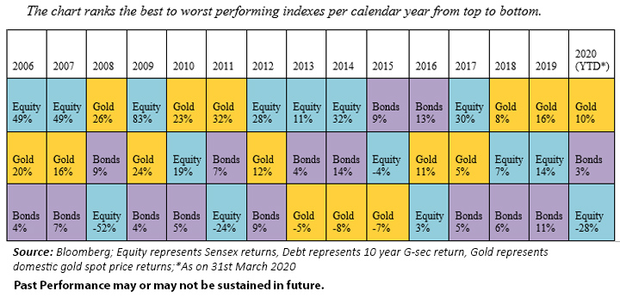
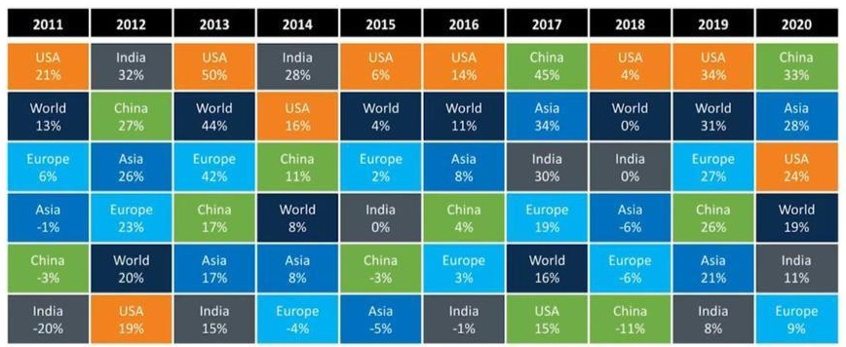
Diversification is Key!
Historical Global Equities Performance

Slide 11
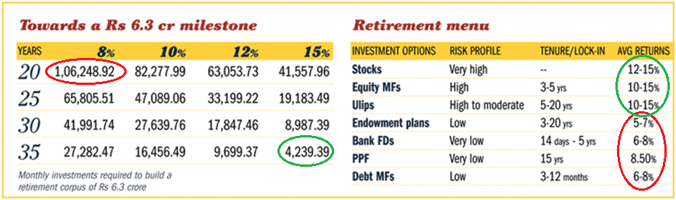
Beat Inflation to grow your Wealth!
Start Early!
Invest at least partly in instruments yielding higher returns
Ensure risk concerns are taken care of appropriately

Slide 12
Common Misconceptions
Financial Planning is for the Rich
Insurance Planning is Financial Planning
Tax Planning is Financial Planning
I am too young to think about Financial Planning
Confuse Financial Planning with investing

Slide 13
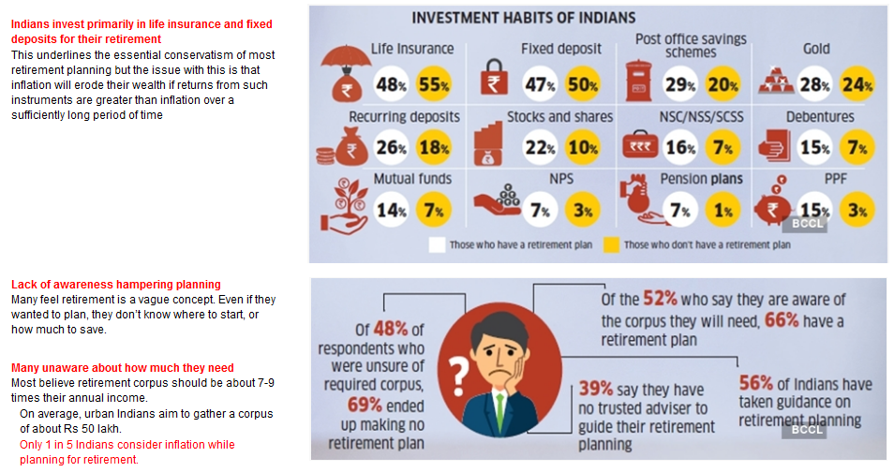
Financial Planning Stats – Retirement

Slide 14

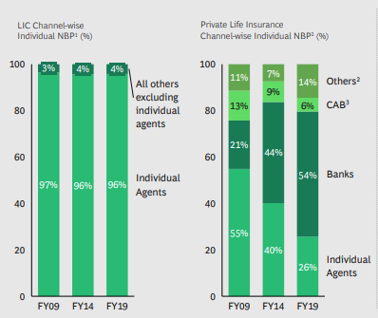
Financial Planning Stats – Insurance
Bulk of insurance policies sold through agents or banks
Direct plans up to 3x cheaper than through intermediaries
Endowment Plans cover a fraction of your real-life insurance needs
Any life insurance plan besides term plans will be sub-optimal in terms of both insurance cover and investment returns

Slide 15

Sample Case Study
Self (39 yrs), Spouse (37 yrs), Son (10 yrs)
Assumed Life-Span: 85 years
Risk Profile: Moderately Conservative
Goals @ current costs
  Son’s Graduation / Post-Graduation: 25 lakhs / 50 lakhs
  Son’s Marriage: 20 lakhs
  Son’s Future Business (Assumed): 50 lakhs
  Retirement Age for Self: 55 years
Salary: Single income, 20 lakhs /yr post-tax. Increment @ 5% annual
Current value of Investments: 2.24 cr
  Equity: 44 lakhs / Fixed Income: 1.03 cr
  Real Estate: 55 lakhs (excluding own house) / Gold & Cash: 22 lakhs
Outstanding Loans (House, Car): 30 lakhs
Annual Recurring Expenses
  Household: 6 lakhs
  Insurance / Travel / Contingency: 4.1 lakhs

Slide 16
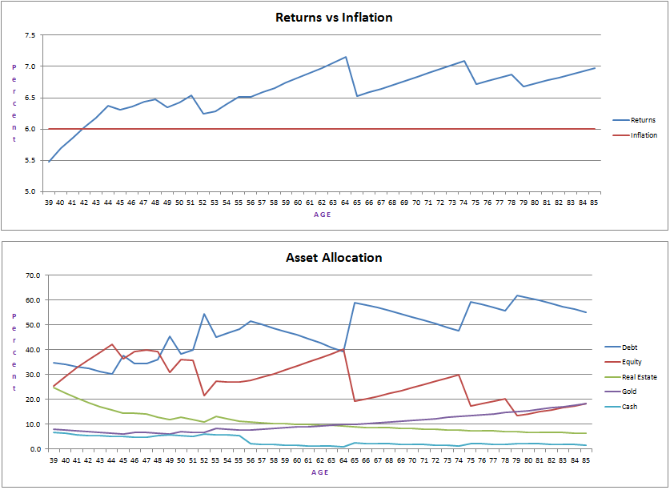
Sample Retirement Plan - Details

Slide 17
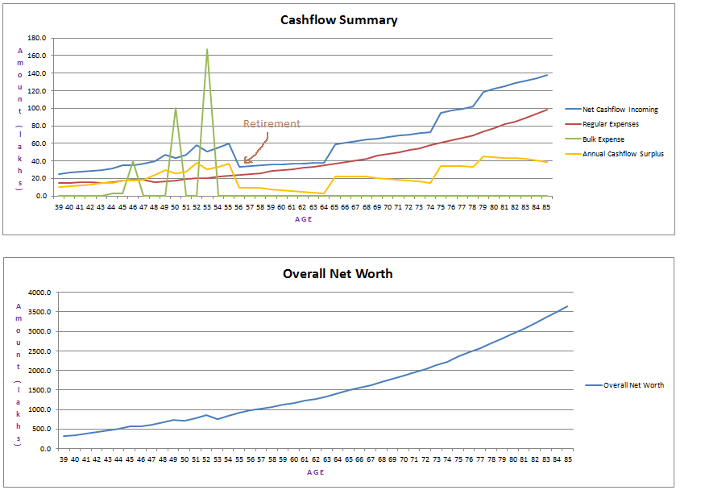
Cashflow Summary & Net Worth

Slide 18
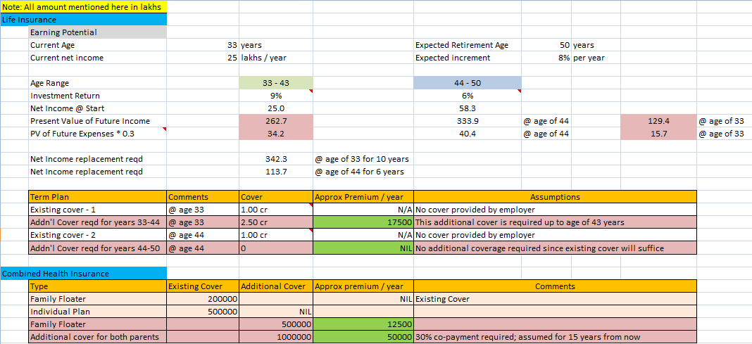
Sample Insurance Recommendation

Slide 19
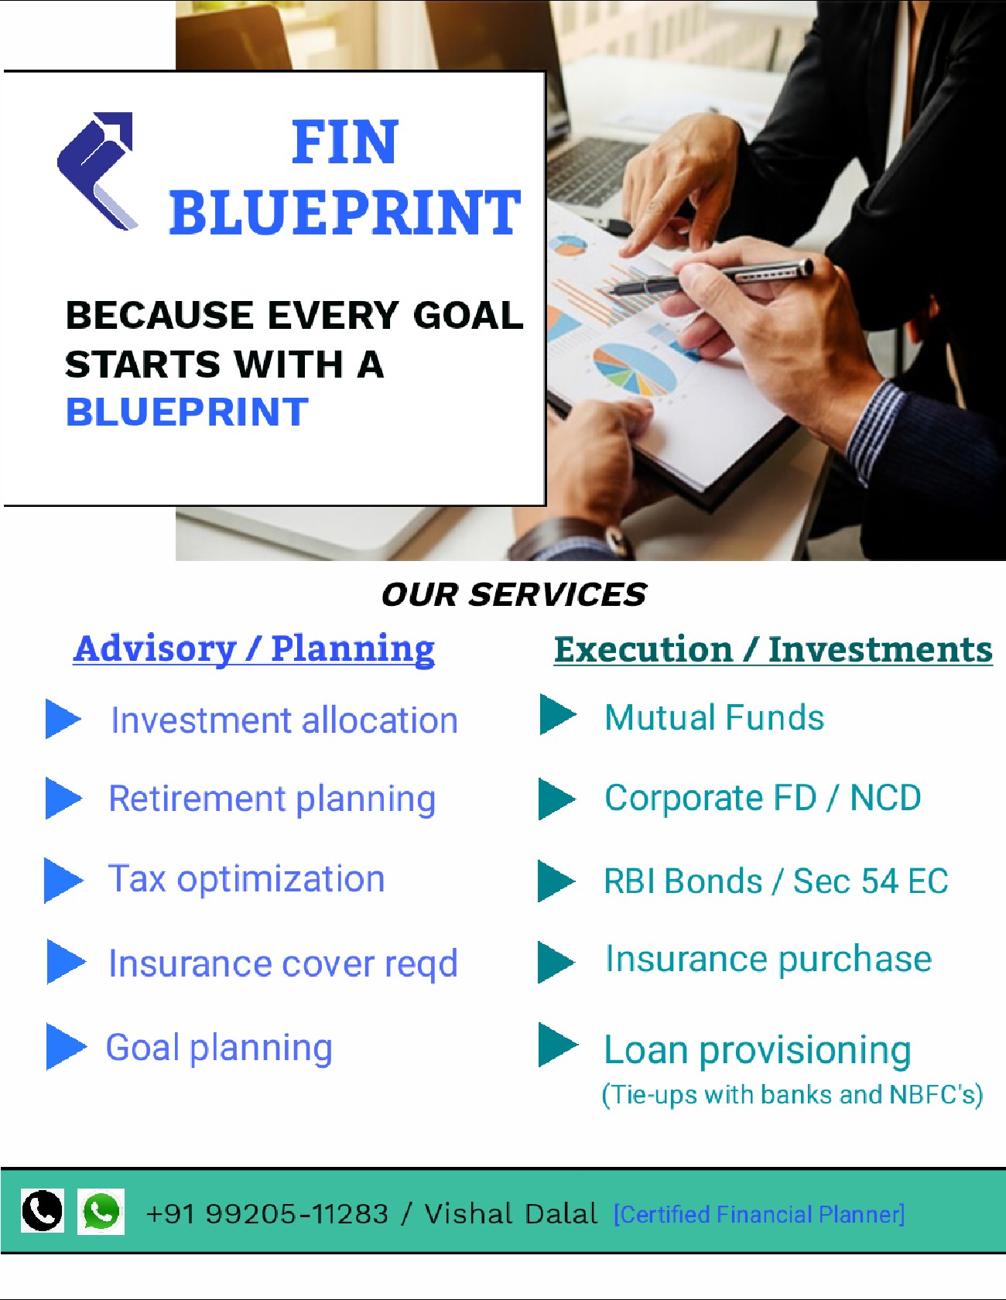

THANK YOU
Contact: +91 99205-11283
Website: www.finblueprint.in
Whatsapp Group: Join

